Slide 1
Report Writing
Praxis
(F27PX1)
Steve Gill
Derived from slides put together by
Brian Palmer and Helen Hastie
©BVWP 2003/11 Praxis (F27PX1)

Slide 2
Introduction
Your reports will normally be technical in nature.
In a report, you are trying to get across ideas and information to other people (readers or listeners).
As a technical professional, you need to be able to communicate effectively in writing (and in speech).
Mistakes can annoy and distract a reader, and lead him or her to undervalue the substance of what you’ve written.
©BVWP 2003/11 Praxis (F27PX1)

Slide 3
Think who your audience is
Your instructor (…not really)
Your peers (…maybe)
Whole world (…tricky)
Scientific audience, early adopters, age-range, background/education?
©BP/HH 2003/12 Praxis (F27PX1)

Slide 4
Report Structure
  A beginning (introduction)
  A middle (main report)
  An End (summary/conclusion)
  Summary/Abstract
  Introduction
  Theory
  Method
  Results
  Discussion of Results
  Conclusions
©BP/HH 2003/12 Praxis (F27PX1)

Slide 5
Standards
A report should have an introduction that explains briefly what the report is about.
A report concerns things or events or ideas. You must arrange these in a sensible order. It’s a good idea to give each significant element a heading and a paragraph to itself.
A report should reach a conclusion or at least have a closing statement that rounds it off.
©BVWP 2003/11 Praxis (F27PX1)

Slide 6
Writing style
What you write should be
  clear
  concise
  as short as possible
  as simple as possible
Every sentence you write should make sense.
Use short sentences. (When in doubt, use two short sentences instead of one long one.) Normal guidelines: 15-20 words. Check your newspaper.
©BVWP 2003/11 Praxis (F27PX1)

Slide 7
Long Sentence
The supervising training organisation is obliged to work with the business or employer - and the apprentice - to design a training plan, including the training that needs to occur, how and when that training will take place, who will provide the training, and how that training will be assessed.
http://www.kerryr.net/webwriting/techniques_long-sentences.htm
©BVWP 2003/11 Praxis (F27PX1)

Slide 8
Long Sentence
could be rewritten as
The supervising training organisation works with employers and apprentices to design a training plan. This training plan includes details of:
  training requirements,
  training delivery, and
  assessment.
©BVWP 2003/11 Praxis (F27PX1)

Slide 9
Some very short sentences
Ever tried. Ever failed. No matter. Try again. Fail again. Fail better.
from Worstward Ho!, by Samuel Beckett
©BVWP 2003/11 Praxis (F27PX1)

Slide 10
The habit of taking trouble
Anything you write, for showing to others, represents you.
This will apply strongly later on, when you’re preparing CVs and application letters.
Make the lay-out easy on the eye.
You should check your spelling. (A spelling-checker helps but is not enough by itself.)
It is estimated that 50% of CVs contain spelling mistakes or grammatical errors (Guardian, Aug 6th 2004). Such mistakes come top of the list of things not to do in a CV
©BVWP 2003/11 Praxis (F27PX1)

Slide 11
Meaning
In the past, it was felt that report writing should be objective, or at least impersonal.
There is nowadays a shift towards the personal, with use of the first person.
Referencing from reliable sources provides some semblance of objectivity.
It's not enough to report facts and the opinions of other people. You must shape the report: you select what goes in, you decide what to say. Above all, you must try to abstract and present meaning.
©BVWP 2003/11 Praxis (F27PX1)

Slide 12
Example Contents Page
Full reports:
  Title page
  Abstract
  Introduction
  Methodology
  Results
  Analysis
  Conclusions
  References
Praxis essays:
  Title, name, course, date
  Introduction
  Main body of report with multiple (headed) paragraphs
  Summary or conclusion
  A final section of references.
©BVWP 2003/11 Praxis (F27PX1)

Slide 13
Referencing
The Vancouver system (number or citation sequence)
The Harvard system (author-date scheme)
Lots of variants thereof
Often depends on where you are publishing.
Be consistent.
Give as much information as possible.
©BVWP 2003/11 Praxis (F27PX1)

Slide 14
The Vancouver System
“Bloom, Earwicker et al. [1] report that unhappiness makes people sad.”
Or
“It has been reported that unhappiness makes people sad [1].”
List references in the order in which they appear in the text.
References
  1. Bloom L, Earwicker HC et al. (2004) A new theory of sadness, International journal of the obvious, vol.34, no.4, pp.345-356.
©BVWP 2003/11 Praxis (F27PX1)

Slide 15
The Harvard System
“Bloom and Earwicker (2004) report that unhappiness makes people sad.”
Or
“It has been reported that unhappiness makes people sad (Bloom, Earwicker, et al. 2004).”
List references in alphabetical order.
References
  Bloom L, Earwicker HC (2004) A new theory of sadness, International journal of the obvious, vol.34, no.4, pp.345-356.
©BVWP 2003/11 Praxis (F27PX1)

Slide 16
Referencing Web Documents
A newish and special case.
Web pages change, move and/or disappear.
Include the full URL (universal resource locator) and the date the document was accessed.
Say what the URL’s about (obvious to you, but not necessarily to the reader)
Examples:
  Metterklume S (no date) Dr S Metterklume, Heriot-Watt University, http://www.macs.hw.ac.uk/~smetterklume/, [accessed 10/10/02].
  BBC (2002) BBC - BBCi - the UK's number one digital destination, http://www.bbc.co.uk/, [accessed 10/10/02].
©BVWP 2003/11 Praxis (F27PX1)

Slide 17
Exercise
http://library.northampton.ac.uk/liberation/ref/basic_harvard_ex1.php
Useful docs
http://www.hw.ac.uk/is/docs/Harvardguide.pdf
http://www.library.dmu.ac.uk/Images/Selfstudy/Harvard.pdf
BP/HH 2003/12 Praxis (F27PX1)

Slide 18
Plagiarism & Collusion
Plagiarism and collusion (for individual work) will be severely penalised.
Collusion: extensive collaboration leading to similar results.
Plagiarism: unfair or inappropriate use of another's work.
We have to report any suspected case to the dean.
Your reports must not consist of slabs of text pasted from web-sites.
If you feel that a particular sentence sums up what you want to say, put the text in quotes and give it a reference.
All the same, a sequence of quotations is not a report. We want to see your own words. These are evidence that the ideas have passed through your mind.
©BVWP 2003/11 Praxis (F27PX1)

Slide 19
Non-textural Content
Pictures cheer things up.
Technical reports often contain figures and tables.
Give each a numbered legend.
Don’t orphan the item.
‘One picture is worth ten thousand words’, attributed to Frederick Barnard; a North American adman; said it was a Chinese (initially Japanese) proverb to give it cred.
A more recent estimate is 84.1
©BVWP 2003/11 Praxis (F27PX1)

Slide 20
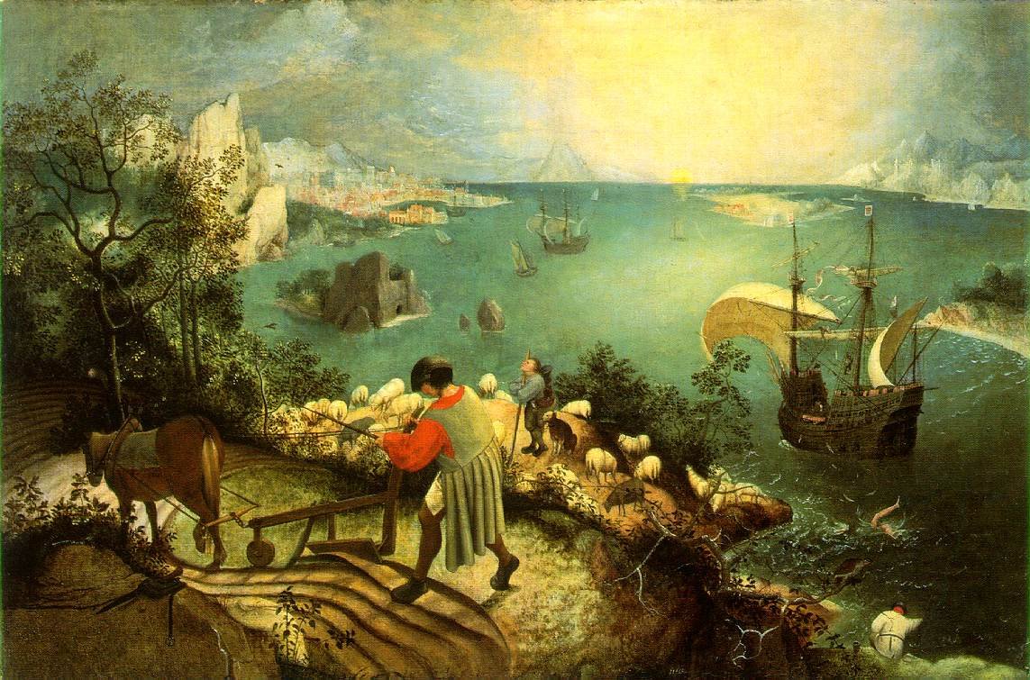
Non-textural Content
Figure 1 – The Fall of Icarus, by Bruegel
Figure 1 shows the partial failure of a bold experiment. It is worth noting that nobody seems to care. “About suffering they were never wrong, the Old Masters.” (Musee des Beaux Arts by WH Auden).
©BVWP 2003/11 Praxis (F27PX1)

Slide 21
What irritates readers
Bad punctuation
Bad spelling
Jargon
"Generally hard to understand"
Misuse of words
Unexplained acronyms
Unclear technical terms
(Guardian, July 26th 2004, report on the Plain English Campaign)
©BVWP 2003/11 Praxis (F27PX1)

Slide 22
Person
The first person is I, me, my, we, our, etc.
The second person is you, your etc.
The third person is he, she, they, their, his, hers, him, her, etc.
Until recently, the first and second persons were seldom used in formal documents.
Nowadays, we are starting to be less formal.
I prefer the third person.
©BVWP 2003/11 Praxis (F27PX1)

Slide 23
Using the Third Person
“The author found…” (avoiding the first person)
“Research has found …” (impersonal)
“It was found…” (passive voice)
It’s much used in scientific writing, but can make things rather dull to read. (Nobody ever seems actually to do anything.)
©BVWP 2003/11 Praxis (F27PX1)

Slide 24
The apostrophe
It's means it is.
Her, his and its (possessive) have no apostrophe.
Singular possessive apostrophe, e.g. "Student's marks" means the "marks of the student".
Plural possessive apostrophe, e.g. "Students' marks" means the "marks of the students".
If you really can’t handle the apostrophe, leave it out altogether.
©BVWP 2003/11 Praxis (F27PX1)

Slide 25
e.g. and i.e.
e.g. is short for exempli gratia and means "for example"
i.e. is short for id est and means "that is"
There is almost never any very good reason for using either
©BVWP 2003/11 Praxis (F27PX1)

Slide 26
Other Tips
Their (possessive pronoun)/there (adverb indicating place, pronoun etc)/they're (they are)
From/form (one of many mistakes not picked up by spelling checkers)
Principal: usually a person, the head of something
Principle: a basic truth, law, idea or assumption (not a person)
To: preposition (to go) or adverb (to town)
Two: number
Too: adverb (too much, they went too)
Dependant (noun): a person who is kept or supported financially by another
Dependent (adjective) / independent
©BVWP 2003/11 Praxis (F27PX1)

Slide 27
More tips
Define abbreviations once, at first occurrence (even when you think the meaning is obvious).
UK and American English are different.
  Be consistent.
Here’s a list of common mistakes:
http://www.careers.cam.ac.uk/students/work/spelling.asp
Here’s another site:
http://dissc.tees.ac.uk/Mistakes/Spelling/Spell5.htm
©BVWP 2003/11 Praxis (F27PX1)

Slide 28
Proof Reading
Read your own work through slowly and thoroughly. (Reading aloud can help.)
Get someone else to read your work.
Does it really say what you think it says?
Cut out words or phrases that don’t add to your argument.
Repetition is easy to commit and easy to deal with.
©BVWP 2003/11 Praxis (F27PX1)

Slide 29
The completed report
Your account should be:
  complete
  well organised (headings, sub-headings)
  clearly presented (well spaced, nice pictures)
  intelligibly written (meaningful sentences)
  without irrelevant detail
  without unnecessary repetition
  properly referenced
©BVWP 2003/11 Praxis (F27PX1)

Slide 30
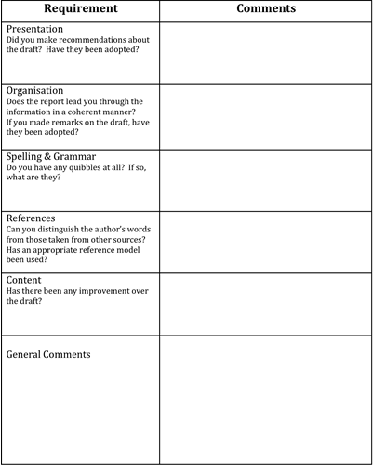
Giving Constructive Criticism
Be positive. Tell the author about what they have done well.
Politely suggest how they can improve their work.
Look out for
mistakes in grammar, punctuation, structure and spelling.
Comment on how well you understood the author's work
How would you have done this differently?
Avoid terse statements such as “perfect” – always room for improvement
BP/HH 2003/12 Praxis (F27PX1)

Slide 31
Tasks for the week
Receive subject for your first report
Research your given topic
  Don't just glance at a couple of web-sites.
  Look at books, read articles, talk to people, and so on.
  Think what you want to say: you will be expected not merely to impart information but to offer opinions.
Write a report of 500 words
Produce 3 hard copies for review in week 4
©BVWP 2003/11 Praxis (F27PX1)

